Slide 1
Classifying Chaotic Synthesizers with a Multimodal Neural Network
Landon Buell
4 Dec 2020

Slide 2
Lets Play a Game
What made the Sound being Played?

Slide 4
The Neural Network
Introduction / Function / Training

Slide 5
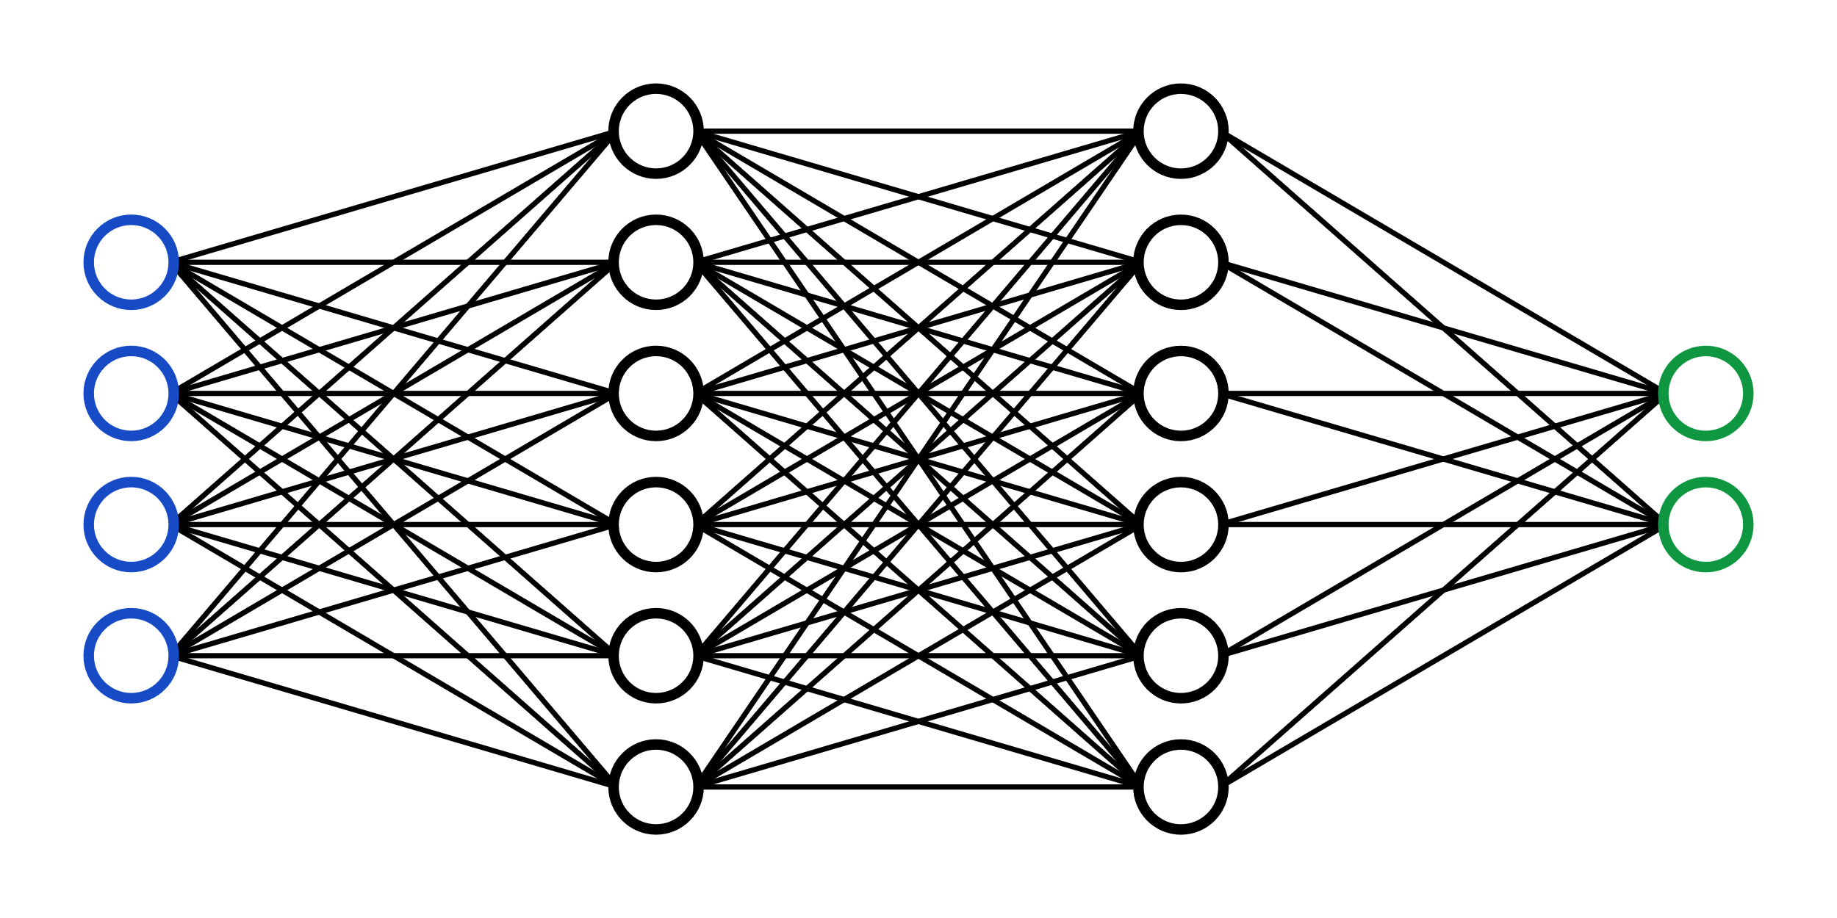
What is a Neural Network?
A Neural network is a mathematical function
Composed of Layers, with “trainable” Parameters
Transform an Input Array into an Output Array

Slide 6
A Classification Model
We map a set of inputs to a qualitative output
We seek to “group” similar inputs
Place them into 1 of K classes
This model is called a classifier

Slide 7
Making Predictions
Input is transformed through repeated calling of layer functions
The output of final layer is the network’s “prediction”
Encode output as a probability distribution over the classes

Slide 8
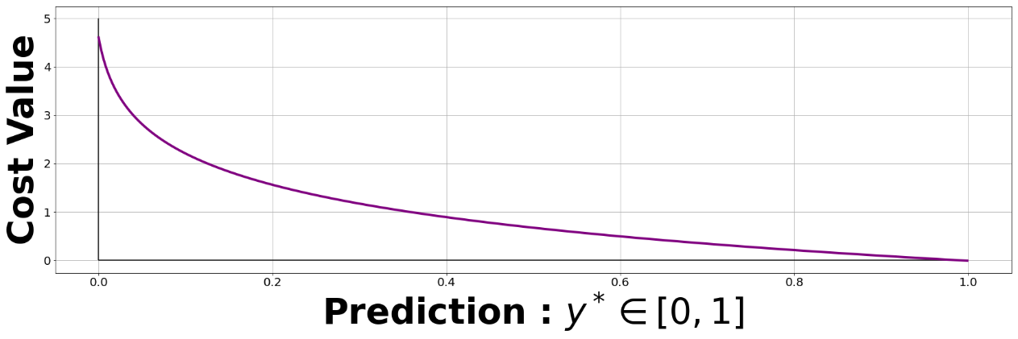

Training A Network
Provide the model with labeled training samples
The model makes a prediction
For an untrained network, this is likely to be very poor
We quantify the error with an Objective Function
Categorical Cross Entropy
$$CXE\left[y,y^{∗}\right]= \sum_{i=0}^{K−1}{y_{i}log⁡(y_{i}^{∗})}$$

Slide 9
Optimization
Choose parameters to minimize the objective function
We do not “train” a neural network
We Optimize a Neural Network

Slide 10

Optimization (Cont.)
“Adaptive-Moments” Optimizer
Powerful, Robust, Stable
Adjust each each parameter to minimize cost function
Based on Gradient Descent
Compute gradient w.r.t cost function

Slide 11
Features Used
Spectrogram / Time-Series / Frequency Series

Slide 12
Why Features?
“The data reduction stage which is also called feature extraction, consists of discovering a few important facts about each class. The choice of features is critical as it greatly affects the accuracy of audio classification.”
- M. Kashif Saeed Khan , Machine Learning Researcher
Features are inputs that we provide to the neural network

Slide 13
Consider The Task
Consider Making a binary classifier model
Been to space vs. have not been to space
Consider the features
Date of Birth
Eye Color
Country of Birth
Which are useful? Which are not?

Slide 14
How are Features Chosen?
“For recognition algorithms, the necessary property of the acoustic features is low variability among features extracted from examples assigned to the same class, and at the same time high variability allowing distinction between features extracted from examples assigned to different classes”
- Tuomas Virtanen, Machine Learning & Audio Engineer

Slide 15
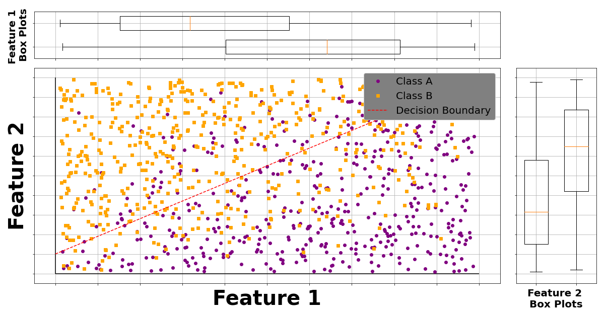
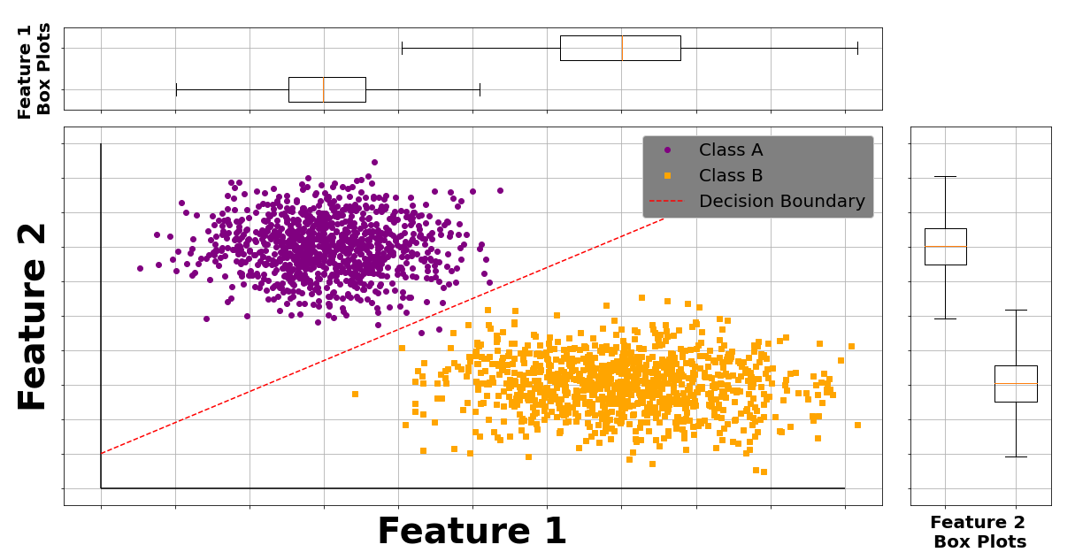
Decision Boundaries
Separable
Non-Separable

Slide 16
The Spectrogram
Provides a 2D image-like representation of a waveform
Maps energy over frequency and time
Time passes on X-axis
Frequency on Y-axis

Slide 17
More Spectrograms

Slide 18
Time Domain Envelope
Estimate Energy in Time-Domain
Divide waveform into 5 sections
Compute TDE for each, use as features

Slide 19
Zero Crossing Rate
Number of times a waveform crosses equilibrium
Often used in Speech vs. Music Detection
Identifies Jagged vs. periodic waveforms

